Slide 1


“IMAGE TO TEXT AND TEXT TO SPEECH USING CRNN”
Project Presentation on
PRESENTED BY:
RATHAN R NAYAK (4MW20CS062)
SHERIGAR PRADWIN MADHAVA (4MW20CS074)
SRIHARSHA UPADHYA P (4MW20CS090)
SUHAS BHAT (4MW20CS093)
Under the Guidance of
Mr.Raghavendra G. S.
Assistant Professor
Dept. of CSE
SMVITM, Bantakal

Slide 2
INTRODUCTION :
The Image-to-Text component of this project tackles the problem of transforming diverse image sources.
Optical Character Recognition (OCR) has made significant strides in recent years, but it still faces numerous challenges in accurately detecting and transcribing text.
The Image-to-Text system will aim to develop goes beyond more recognition,it will possess the ability to intelligently process, understand, and extract textual content from images

Slide 3
This project aims to push the boundaries of TTS technology, delivering voices that sound human voice.
By integrating both the Image-to-Text and Text-to-Speech components, this project seeks to bridge the gap between visual content and auditory communication, offering a unified system that converts images into spoken language

Slide 4
LITERATURE REVIEW :
[1] The Paper “Text extraction from documents images using edge information” by Swami Datta and Vasanth focuses on the detection of text from a colored images using edge-based feature. Its aim is to differentiate text from non-textual portion.
However, there are some limitations like the generalized text segmentation method is not defined.

Slide 5
[2] The paper “Text Recognition using Image Processing” focuses on text extraction using image processing. The image processing includes the pre-processing, segmentation, classification and post processing stages. However, there are some limitations like the model works offline, so if a user needs to perform text extraction, he/she need to perform the text extraction on their own system.

Slide 6
LITERATURE REVIEW :
[3] In “Image to Text Conversion Using Tesseract” the paper discusses optical character recognition (OCR) techniques for extracting text from scanned documents or images and converting them to editable digital form.
Earlier OCR methods used convolutional neural networks, but they had higher error rates. The Tesseract OCR engine uses Long Short-Term Memory (LSTM) from recurrent neural networks (RNN), which is better suited for recognizing handwritten text and larger portions of text data.

Slide 7
[4] In “Connected Component Based Approach for Text Extraction from Color Image” The process begins with pre-processing, where the input image is divided into two equal sub-images. These sub-images are converted to grayscale and then to binary images. Next, each text region in the sub-images is identified by bounding the connected components. Finally, the text extraction process is carried out through multiple steps, including feature emphasis, character extraction, and noise reduction/refinement.

Slide 8
[5] In “A Novel Image Text Extraction Method Based on K-means Clustering ” the paper proposes a novel method for image text extraction that consists of two main steps: text localization and text segmentation. The text localization step uses a multi-scale approach to locate texts with different font sizes, and then refines the located regions using projection profiles.
For text segmentation, the method uses k-means clustering in the RGB color space, which is shown to be more robust to complex backgrounds compared to traditional thresholding methods. Experimental results demonstrate that the best performance is obtained when k is set to 3 in the k-means clustering.

Slide 9
[6] In “OCR Based Image Text To Speech Conversion Using MATLAB “ the project aims to develop a cost-effective and user-friendly text-to-speech conversion system for visually impaired people using MATLAB. It captures an image containing text, performs optical character recognition (OCR) to extract the text, and then converts the recognized text into speech audio output. The key steps involve image preprocessing, segmentation of text lines/words/characters, feature extraction, character recognition,resizing text, and finally text-to-speech conversion using MATLAB's libraries. The real-time system does not require internet connectivity and can enable visually impaired users to have documents, books, etc. read out aloud through this image-to-speech process implemented fully in MATLAB.

Slide 10
[7] In “Text To Speech System For Kannada Language”
This paper presents an TTS system designed especially for Kannada language.
Proposed work uses concatenation method of speech synthesis on MATLAB to achieve high degree of accuracy.
The algorithm for a TTS system for Kannada Language is as follows:
Kannada text is converted into English form by using Baraha Software.
This text data is in .txt extended format and is imported to MATLAB environment.
Input text is split into smaller groups as lines ,words and letters.
Words are segmented based on set of rules framed
Sounds of minimum no of words are recorded; phonemes are extracted and then imported into MATLAB
Thus speech output is obtained.

Slide 11
Objectives:
Document Conversion: OCR facilitates the conversion of scanned documents or image files into editable and searchable text formats, such as Word documents or PDFs with selectable text.
Accuracy Improvement: To continually improve the accuracy of OCR technology, especially for challenging cases like complex layouts.
Language Translation: Convert the extracted text into different languages to cater to a diverse audience and support multilingual needs.
Accessibility: To provide accessible content for individuals with visual impairments, allowing them to listen to textual content.

Slide 12
PROBLEM STATEMENT :
In today's digital age, there is an increasing demand for efficient and accessible methods of converting information between different modalities, such as images and text, as well as text and speech. This demand arises from various domains, including assistive technology for individuals with visual or hearing impairments, language translation, and more. However, the accurate and reliable conversion between these modalities remains a challenging task due to the complexity and diversity of the data involved.

Slide 13
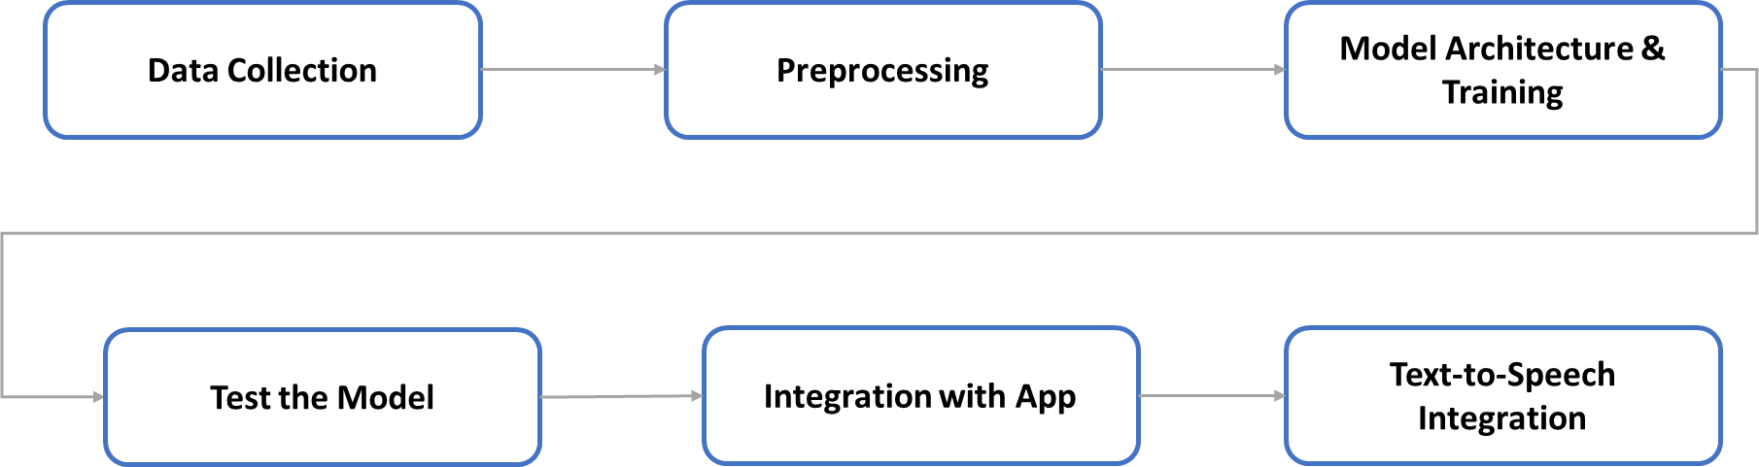
METHODOLOGY:

Slide 14
METHODOLOGY- Data Collection
Define Dataset Requirements: Specify the types of text variations needed (fonts, styles, sizes). Capture text in diverse real-world scenarios, considering challenging conditions.
Collect Data: Explore existing OCR datasets (e.g., academictorrents,MNIST, IAM Handwriting) for diversity. The data is downloaded from academic torrents (https://academictorrents.com/details/3d0b4f09080703d2a9c6be50715b46389fdb3af1)
Preprocess Images: Resize, normalize, and enhance contrast of images. Remove artifacts or unnecessary elements for clean data.

Slide 15

METHODOLOGY- Data Collection
This Dataset is a huge dataset total of 10 GB images. Here I have used only 400000 images for the training set. This data contains text image segments which look like images shown below:

Slide 16
METHODOLOGY- Preprocessing
In order to make it accept the dataset for our model, we need to use some preprocessing. We need to preprocess both the input image and output labels.
To preprocess our input image:
Read the image and convert into a gray-scale image
Make each image of size (32,128) by using padding
Expand image dimension as (32,128,1) to make it compatible with the input shape of architecture
Normalize the image pixel values by dividing it with 255.

Slide 17
METHODOLOGY- Preprocessing
To preprocess the output labels:
Read the text from the name of the image as the image name contains text written inside the image.
Encode each character of a word into some numerical value by creating a Function ( as ‘a’:0, ‘b’:1 …….. ‘z’:26 etc ). Let say we are having the word ‘abab’ then our encoded label would be [0,1,0,1]
Compute the maximum length from words and pad every output label to make it of the same size as the maximum length. This is done to make it compatible with the output shape of our RNN architecture.
In preprocessing step we also need to create two other lists: one is label length and other is input length to our RNN. These two lists are important for our CTC loss. Label length is the length of each output text label and input length is the same for each input to the LSTM layer which is 31 in our architecture

Slide 18
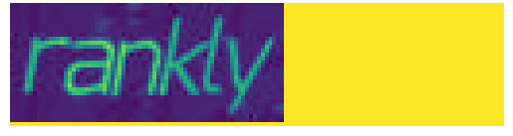
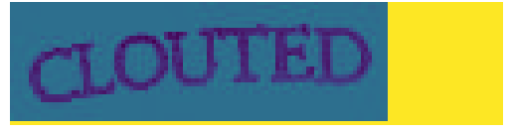
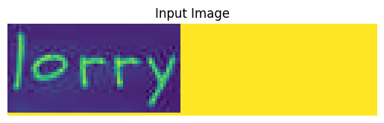
Before Preprocessing After Preprocessing

Slide 19
METHODOLOGY- Model Architecture
we will create our model architecture and train it with the preprocessed data.
Model = CNN + RNN + CTC loss

Slide 20
METHODOLOGY- Model Architecture
Our model consists of three parts:
Convolution Neural Network Layer: A convolutional neural network (CNN, or ConvNet) is a class of deep learning, feed artificial neural networks that has successfully been applied to analyzing visual imagery. The convolutional neural network to extract features from the image There are 3 main operations in the CNN: a) Convolution. b) ReLU. c) Pooling or Sub

Slide 21
METHODOLOGY- Model Architecture
Convolution layer: The primary purpose of Convolution in case of a CNN is to extract features from the input image. Each convolution layer takes image as a batch input of four dimension N x Color-Channel x width x height. The primary purpose of the convolution operation in a CNN is to extract features from the input image.After the convolution operation, the primary parameter that changes in the output feature maps is the width and height of the image.
Rectified Linear Unit: An additional operation called ReLU has been used after every Convolution operation. ReLU stands for Rectified Linear Unit. It's a simple piecewise nonlinear function defined as follows
R(x) = Max(0,x)
Pooling Layer: The primary purpose of the pooling layer is to reduce the spatial dimensions (width and height) of the feature maps while retaining the most important information.Pooling can be performed using different strategies, such as Max Pooling, Average Pooling, or Sum Pooling.

Slide 22
METHODOLOGY- Model Architecture
Recurrent neural network: Recurrent Neural Networks (RNNs) predict sequential outputs by feeding the previous output as input to the current step, enabling tasks like next-word prediction in sentences. RNNs utilize hidden states to remember information about sequences, crucial for tasks like recognition. Long Short-Term Memory (LSTM) networks, a type of RNN, LSTMs are particularly effective in tasks where learning order dependence and handling long-term dependencies are crucial. LSTMs incorporate gates (forget, input, output) that regulate information flow, enabling effective learning and memory retention.

Slide 23
METHODOLOGY- Model Architecture
CTC loss function: CTC (Connectionist Temporal Classification) loss function is used in training Recurrent Neural Networks (RNNs) for tasks such as handwritten text recognition. CTC loss addresses the alignment problem present in handwritten text, where each writer may have a different alignment. Instead of explicitly aligning the input sequence with the target sequence, CTC loss allows training by providing only the ground truth text and the output of the Bidirectional LSTM (BLSTM) network. It calculates the loss by considering all possible alignments between the input and target sequences and aims to minimize the negative maximum likelihood path, thereby optimizing the network to predict the correct output for each time step.

Slide 24
METHODOLOGY- Model Architecture
Network architecture: Let’s see the steps that we used to create the architecture:
Input shape for our architecture having an input image of height 32 and width 128.
Here we used seven convolution layers.
Two max-pooling layers are added with size (2,2) and then two max-pooling layers of size (2,1) are added to extract features with a larger width to predict long texts.
Also, we used batch normalization layers after convolution layers which accelerates the training process.
Then we used a lambda function to squeeze the output from conv layer and make it compatible with LSTM layer.
Then used two Bidirectional LSTM layers each of which has 128 units.

Slide 25
METHODOLOGY- Test The Model
Our model is now trained with 400000 images. To test the model we can not use our training model because it also requires labels as input and at test time we can not have labels. So to test the model we will use ” act_model ” that we have created earlier which takes only one input: test images. As our model predicts the probability for each class at each time step, we need to use some transcription function to convert it into actual texts. Here we will use the CTC decoder to get the output text.

Slide 26
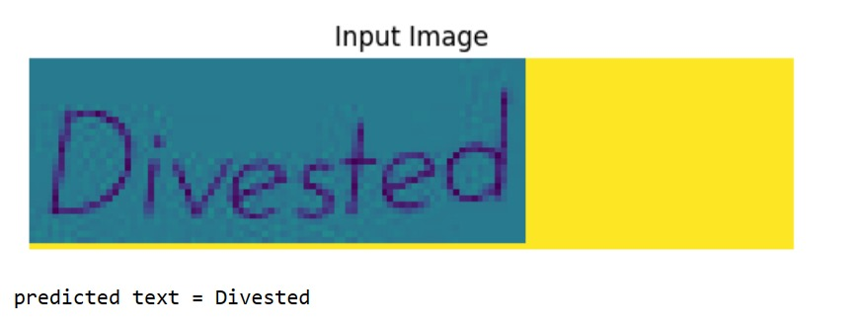
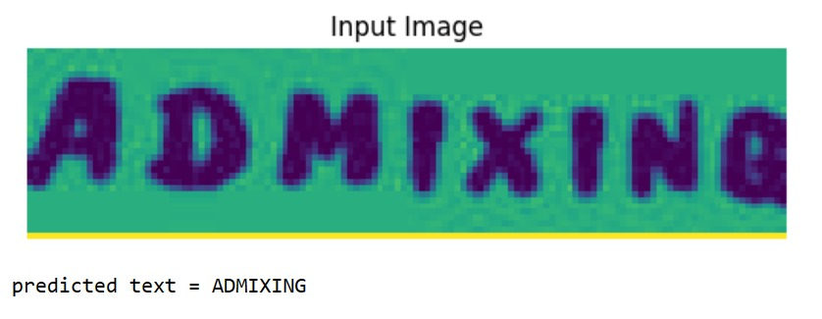
METHODOLOGY- Test The Model

Slide 27
METHODOLOGY- Integration With Web Application
Integrate OCR Model:
Dependencies for the OCR model, including Keras and TensorFlow, are added to the Django web application.
The pre-trained OCR model weights are loaded using act_model.load_weights('./static/models/best_model.hdf5'). This ensures that the OCR model is ready to make predictions when the application is run.
Implement Image Processing:
The application allows users to upload images via a web interface.
The uploaded image is read using OpenCV (cv2.imread) and converted to grayscale (cv2.cvtColor).
Tesseract OCR is utilized to detect and identify text regions within the image. These regions are then cropped for individual processing.

Slide 28
Preprocess Cropped Images:
Each cropped image is resized to a fixed dimension (128x32) to match the input shape expected by the OCR model.
Additional preprocessing includes converting the image to grayscale and normalizing the pixel values.
Extract and Decode Text:
The preprocessed images are passed through the OCR model using act_model.predict.
The CTC (Connectionist Temporal Classification) decoder is used to decode the output of the model into readable text sequences. This decoded text is then compiled into a list of recognized characters.

Slide 29
Display Extracted Text:
The recognized text from the images is compiled and returned by the application.
The application’s front end displays the extracted text, providing a user-friendly interface for users to view the results.
Additional functionalities, such as text-to-speech conversion and translation, can be implemented to enhance user experience.

Slide 30
METHODOLOGY- Text to Speech Integration
Choose Text-to-Speech Tool or API:
Select a reliable text-to-speech tool or API compatible with Django.
We chose the Web Speech API for its simplicity and wide browser support.
Integrate TTS Component:
Add dependencies or integrate the chosen TTS tool into your application.
We included the Web Speech API functionality directly in our JavaScript code on the client side.

Slide 31
METHODOLOGY- Text to Speech Integration
Pass Extracted Text to TTS:
Implement functionality to pass the extracted text from the OCR process to the TTS component.
We added JavaScript code to extract the text from an HTML element and convert it to speech using the Web Speech API.
Implement User Controls:
Develop user controls within the application to manage TTS playback.
We included a "Speak" button that, when clicked, triggers the text-to-speech conversion.
Add Multi-language Support:
Provide an option to translate the extracted text into different languages before converting it to speech.
Integrated Google Translate functionality to translate the extracted text. Re-initialized Google Translate after the content changes to ensure the latest content can be translated.

Slide 32
Future Scope:
Text Recognition: Accurate extraction of text from images and it enables automated data entry, translation of printed data.
Object Recognition: Accurate extraction of text from images like Special Character.
Document Analysis: Understanding the structure of documents which is present in the images.
Multiple Language Support: Ability to convert text into speech in various languages.
Customizable Voice: Allowing user to choose different voices.

Slide 33
Conclusion:
The machine learning project successfully developed a model that translates images into text and implemented it into an effective web application. Tested on real-world datasets This project could significantly impact accessibility, research, and education by converting images to text.
The benefits are measurable, it could improve access to information for people with disabilities, enhance learning outcomes, and increase the publication of image analysis research. Future enhancements could include handling noisy or low-quality images, supporting more speech patterns and languages

Slide 34
REFERENCES :
Farhani, N., Terbeh, N., & Zrigui, M. (2017). Image to Text Conversion: State of the Art and Extended Work. 2017 IEEE/ACS 14th International Conference on Computer Systems and Applications (AICCSA).
Fast and robust text detection in images and video frames.
Song, Y., Liu, A., Pang, L., Lin, S., Zhang, Y., & Tang, S. (2008). A Novel Image Text Extraction Method Based on K-Means Clustering. Seventh IEEE/ACIS International Conference on Computer and Information Science (icis 2008).
Joshi, A., Chabbi, D., Suman M, & Kulkarni, S. (2015). Text to speech system for Kannada language. 2015 International Conference on Communications and Signal Processing (ICCSP).

Slide 35


